Slide 1


Slide 2


Next-generation Blazor components with .NET 6
Daniel Roth & Javier Calvarro Nelson
Microsoft

Slide 3




Reusable Blazor components
.NET
.NET
.NET
Server
WebAssembly
Hybrid

Slide 4







Ready-made Blazor UI components
PARTNERS
Ready-made Blazor UI components
Notes:
.NET has a rich ecosystem of partners building additional tools and controls to help you build beautiful, full-featured, applications faster.
We have many partners releasing support for Blazor, Winforms, and WPF on .NET Core in their tools and controls today as well. SyncFusion, Radzen, Progress Telerik, GrapeCity, Infragistics and DevExpress all have great controls for multiple app models for .NET Core.
THANK YOU!!
<CLICK>

Slide 5









OPEN SOURCE
Thriving open-source ecosystem
bUnit
Ant Design Blazor
Blazm
BlazorStrap
https://aka.ms/awesomeblazor

Slide 6

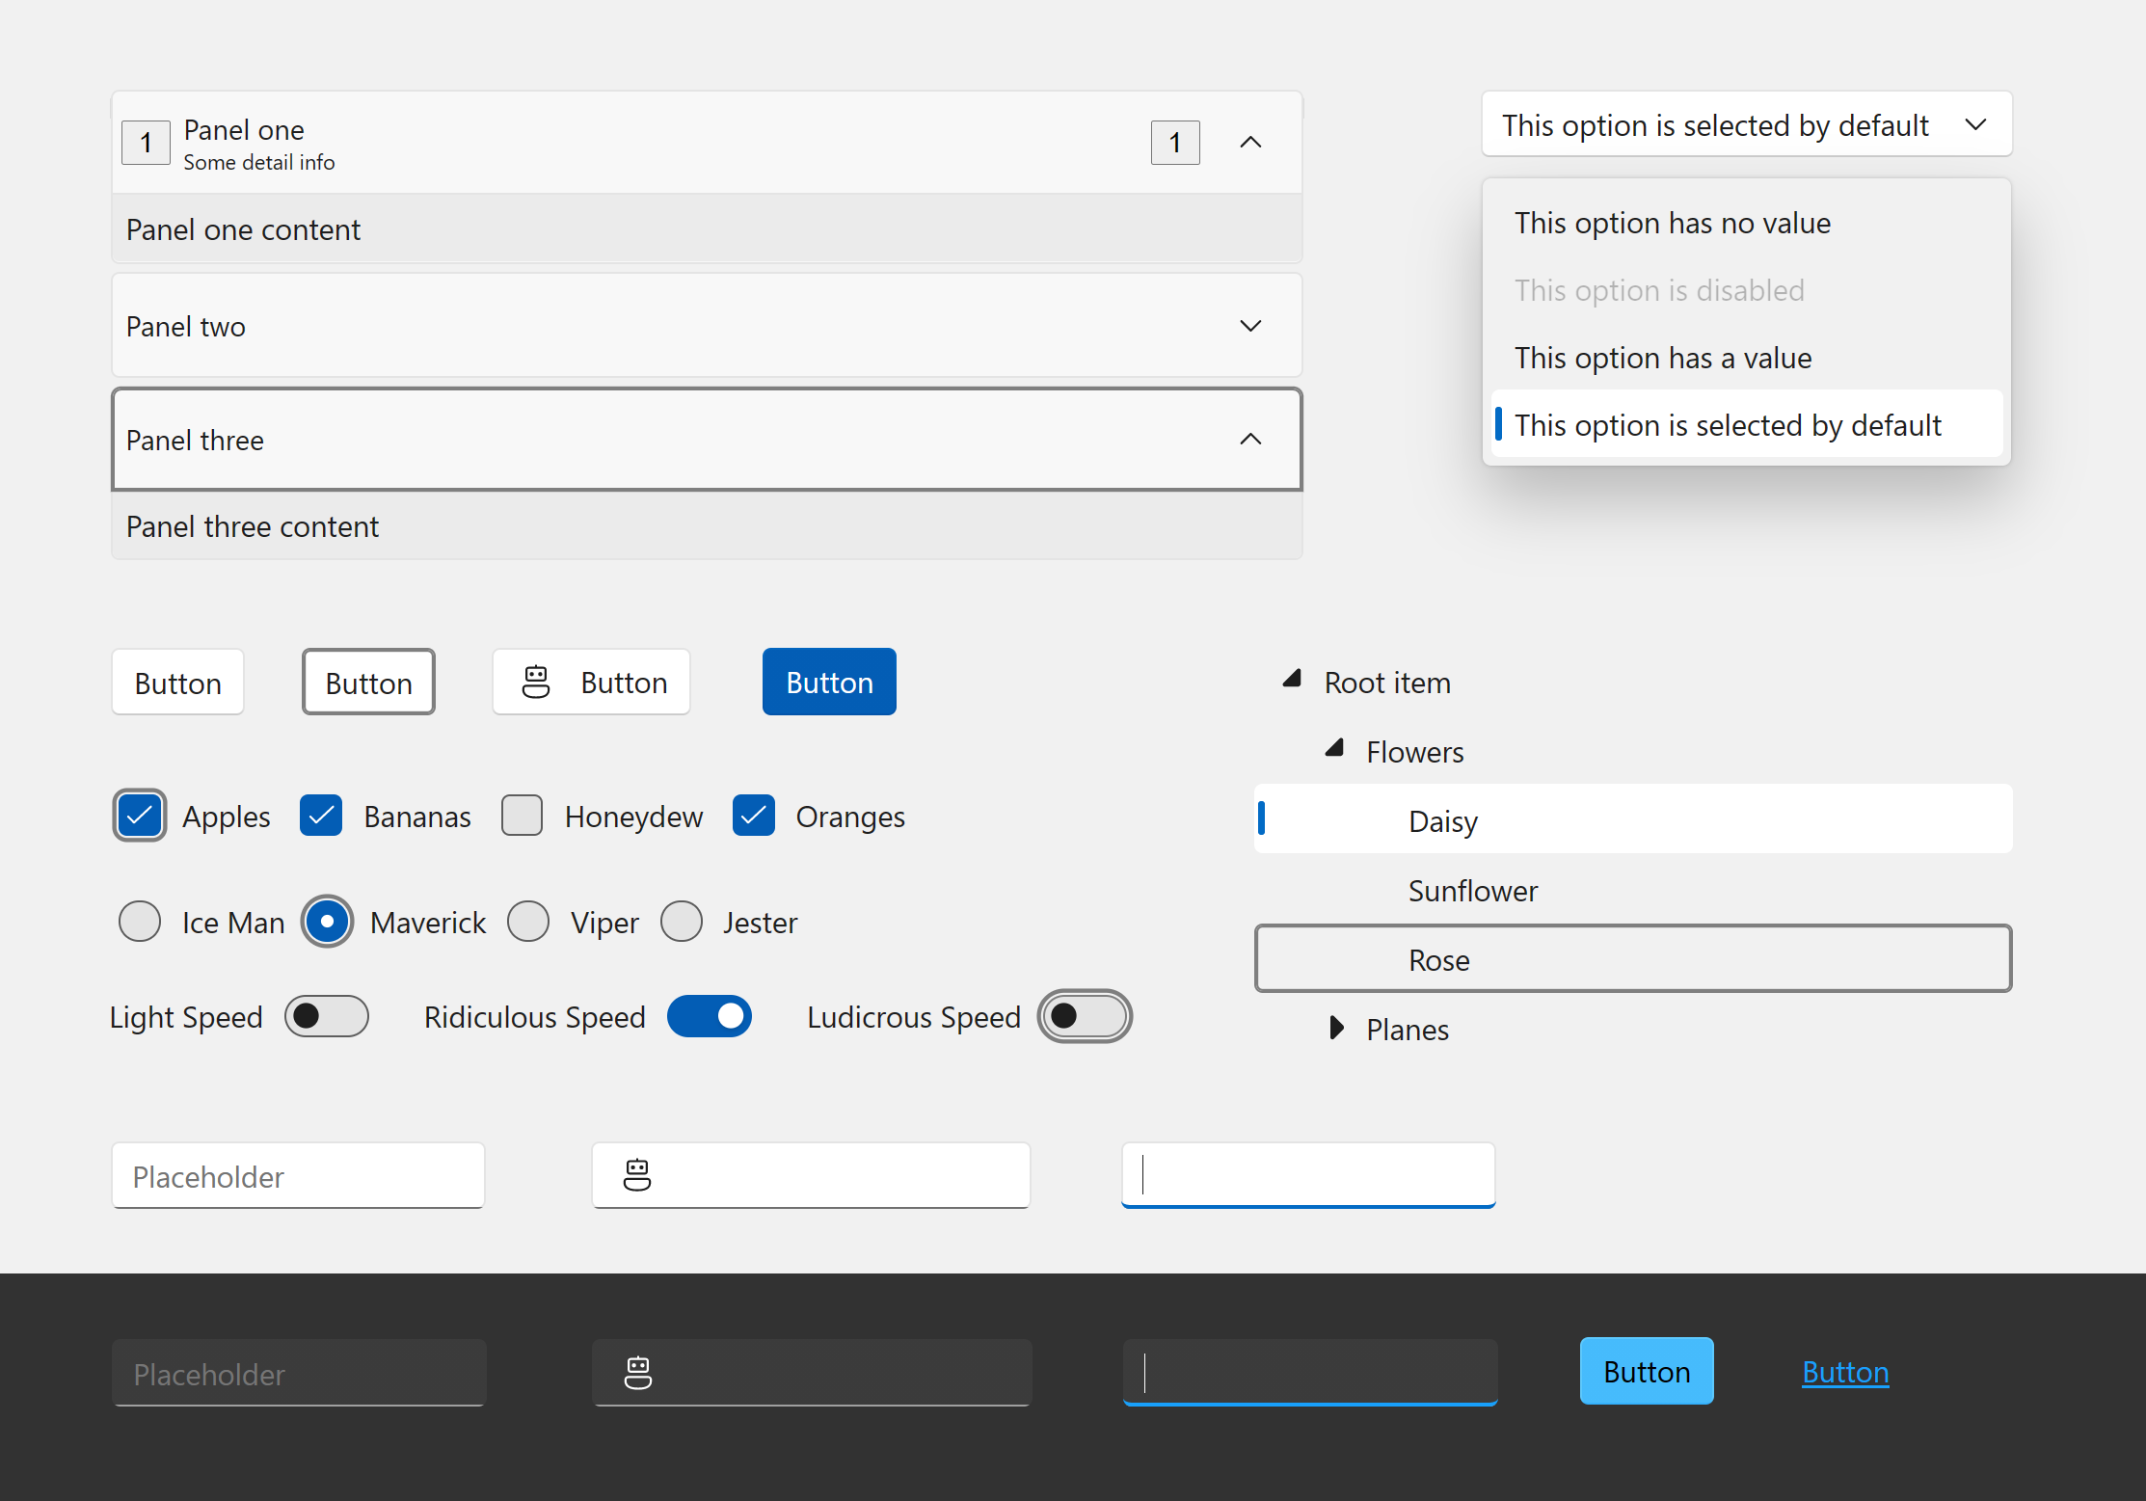
Blazor Fluent UI Components
40+ Blazor components
Fully accessible with light, dark, and high contrast modes
Default styles match the latest Windows 11 Fluent visuals
Integration with web, Windows, Teams, Office, and more
aka.ms/blazor-fluent-ui
Notes:
I’m also happy to announce that the Blazor Fluent UI components have released with over 40 new controls. Fully accessible and styles matching the latest Window 11 fluent visuals.
Check them out and use them in your Blazor apps.

Slide 7
Blazor component model improvements in .NET 6
Required parameters
Infer generic types from parent
Generic type constraints
JavaScript modules per component
JavaScript initializers
JavaScript build process integration

Slide 8
Demo

Slide 9
Blazor component model improvements in .NET 6
Required parameters
Infer generic types from parent
Generic type constraints
JavaScript modules per component
JavaScript initializers
JavaScript build process integration

Slide 10
Additional resources
Build client web assets for your Razor Class Library (.NET blog)
Blazor Fluent UI components: https://aka.ms/blazor-fluent-ui

Slide 11

Thanks for joining!

Slide 12









Slide 13








Slide 14








Slide 15









Slide 16





Slide 17


Slide 18


Slide 19


Slide 20


Slide 21


